Slide 1
Blockchain
Muteeb Akram
(mutnawaz)

Slide 2
Agenda
What is Blockchain?
Demo
What is Cryptocurrency?
Demo
Applications
References

Slide 3
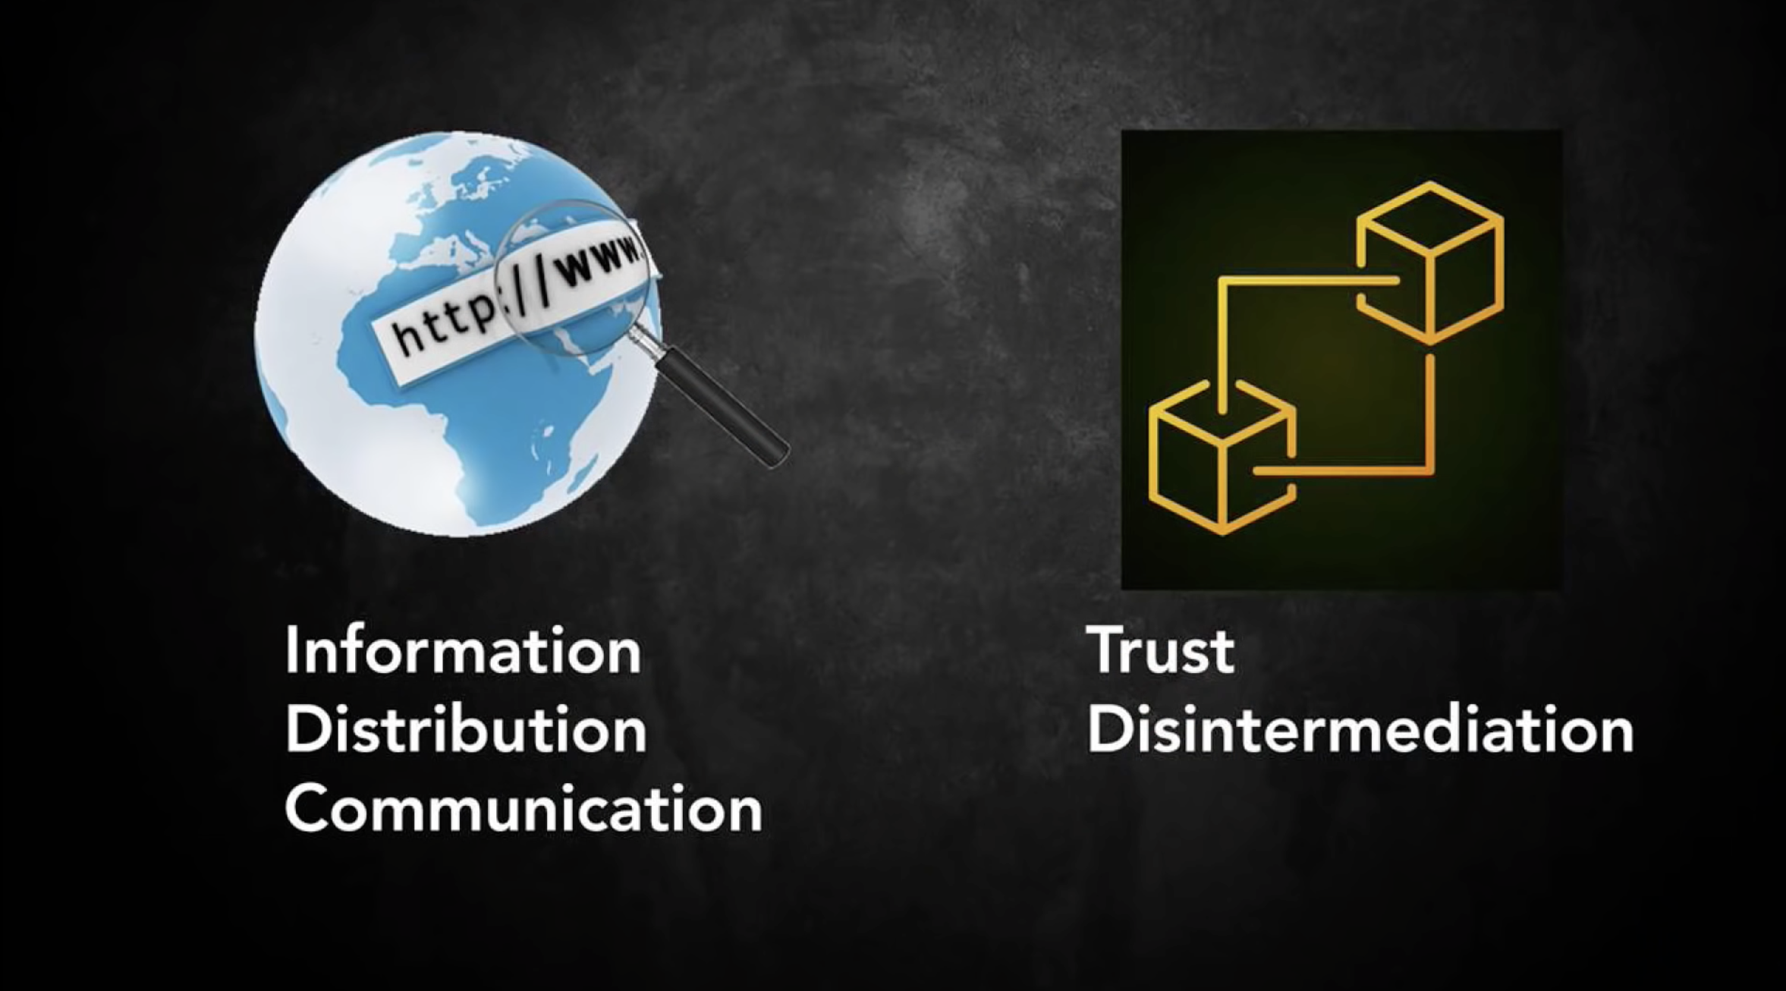

Slide 4
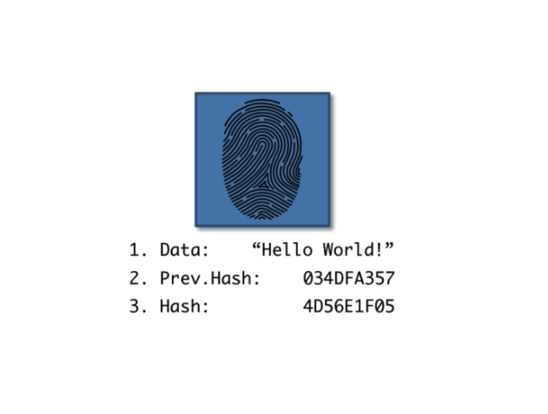
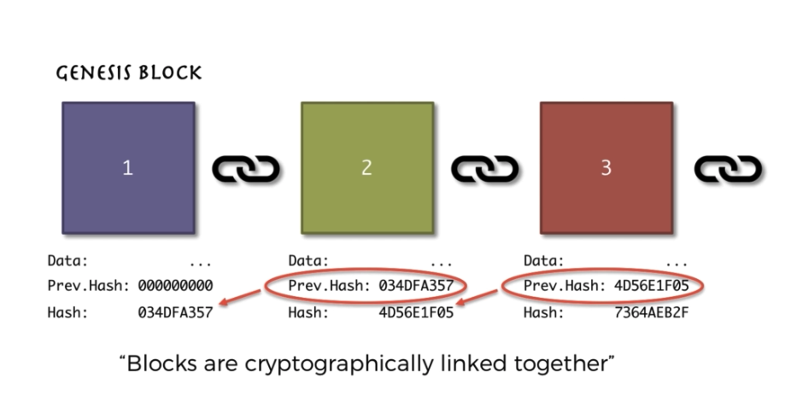
What is Blockchain?
Block
A blockchain is a growing list of records, called blocks, that are linked using cryptography. Each block contains a cryptographic hash of the previous block, a timestamp, and transaction data.
[1] Created By:
Stuart Haber
W. Scott Stornetta
Blockchain

Slide 5
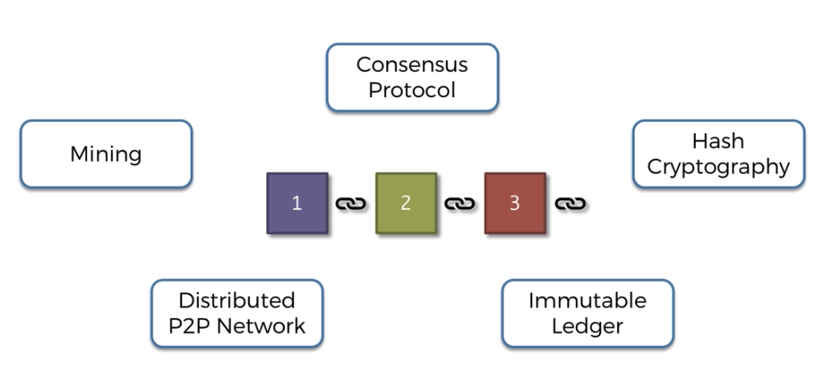
Blockchain Requirements
Hash Cryptography
Immutable Ledger
Distributed P2P Network
Mining
Consensus Protocol

Slide 6
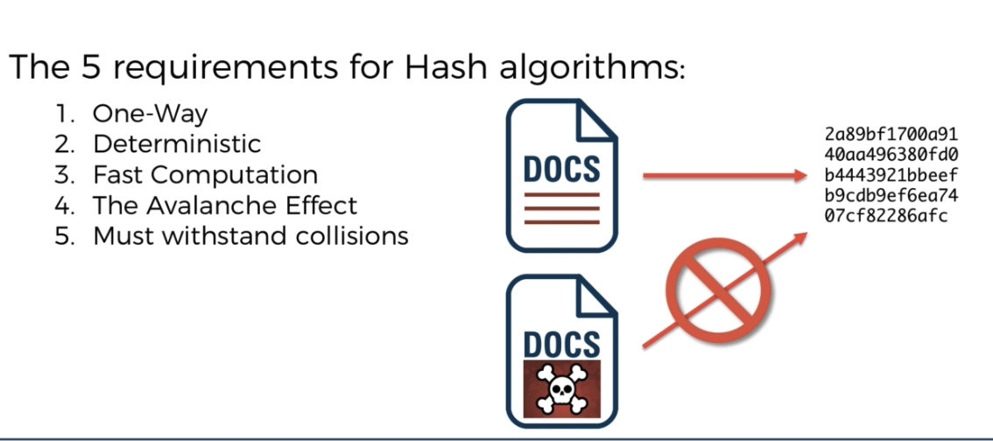
Hash Cryptography
Bitcoin – SHA265 (16^64 = 2²⁵⁶ Possible Hash)
Ethereum - Keccak-256

Slide 7
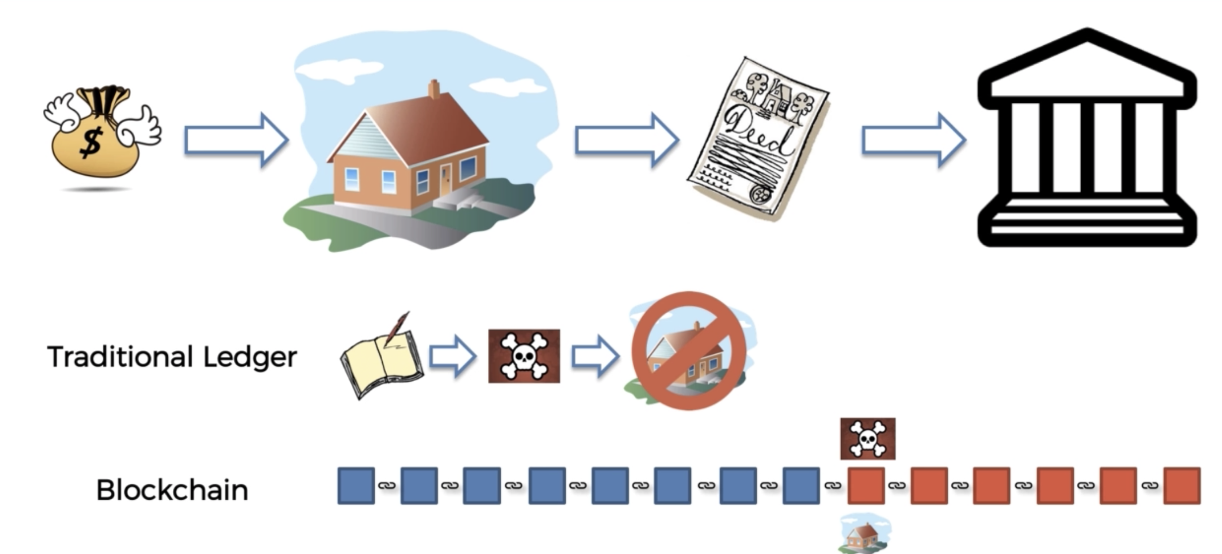
Immutable Ledger

Slide 8
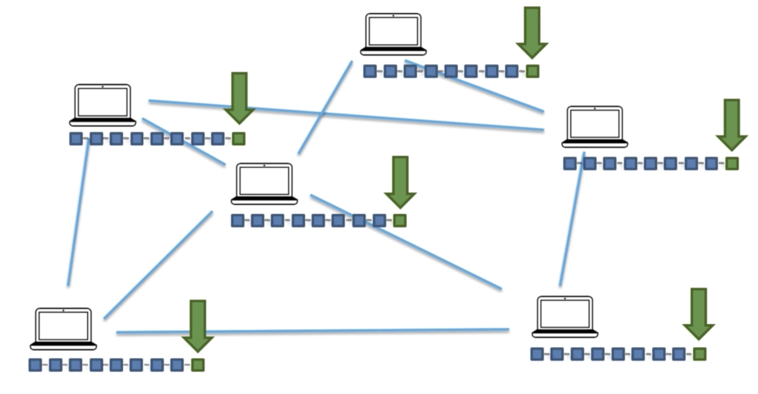
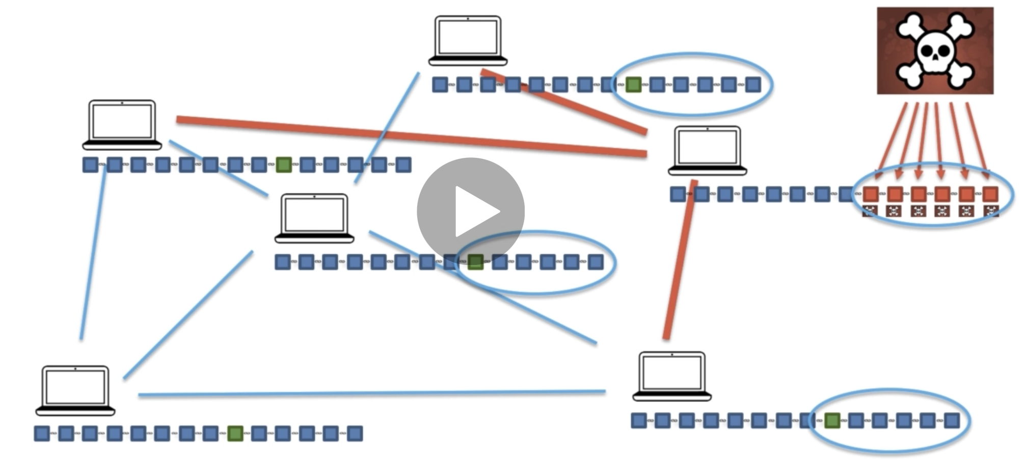
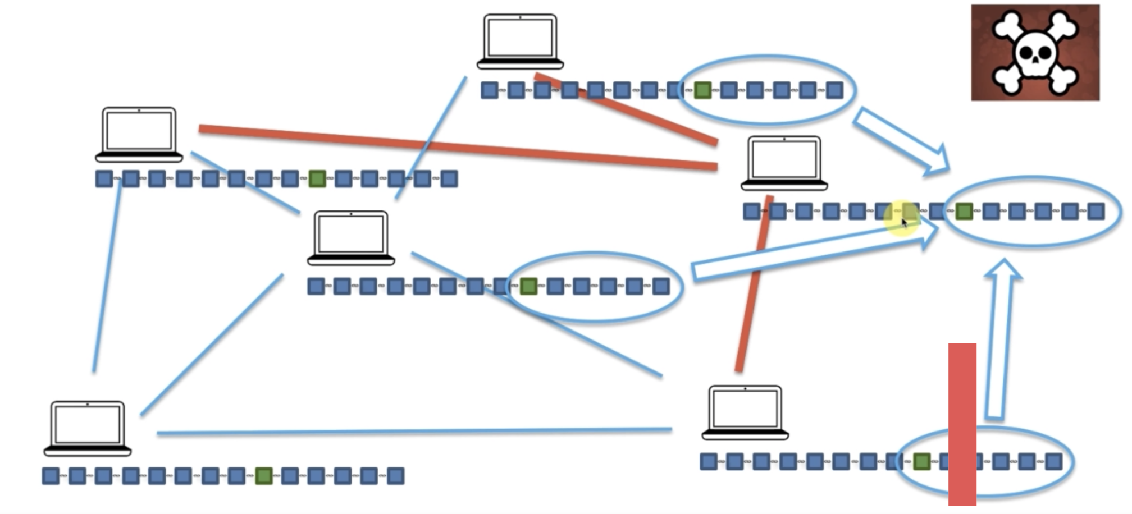
Distributed P2P Network
New Block added to n/w
Someone attacks a node
Node correction by n/w
Thousands of node P2P connected.
Longest chain makes decision in conflict
More than 51% of node needs be changed to hack

Slide 9
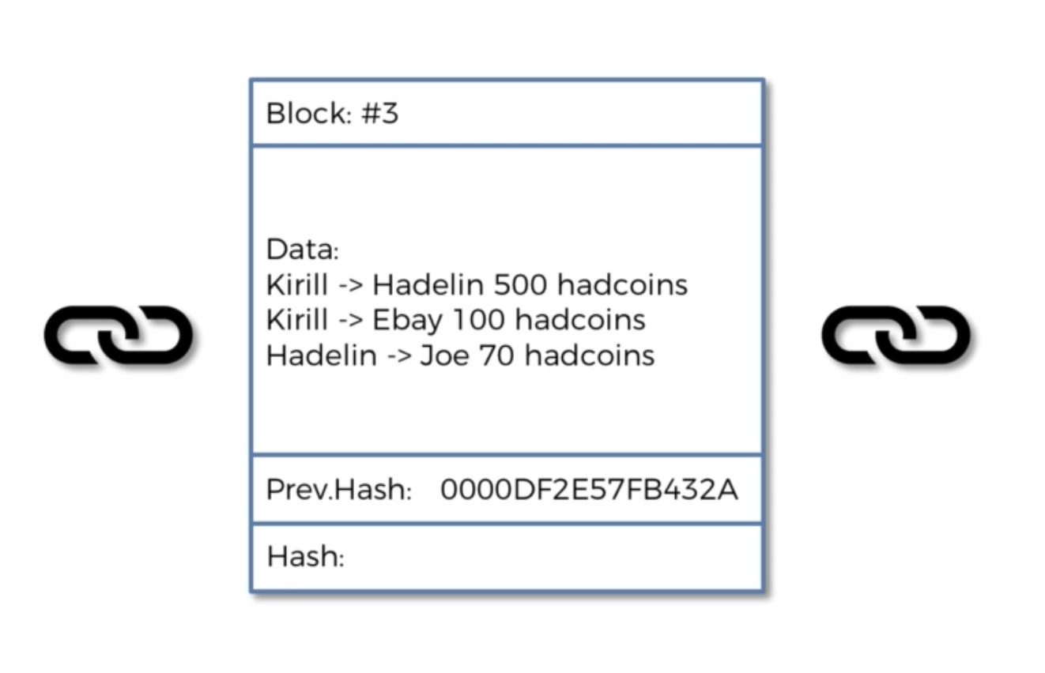
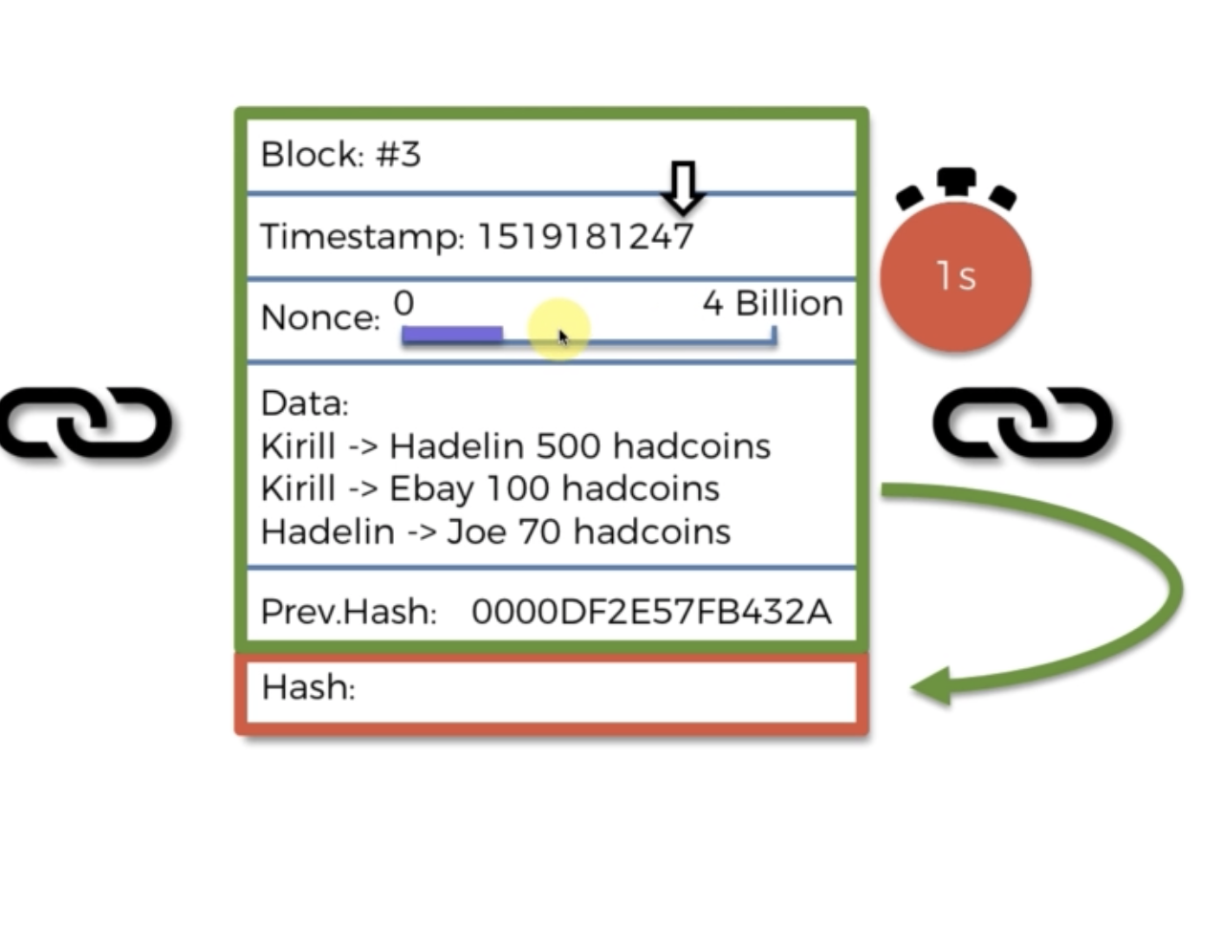
Mining
Mining is process of adding new blocks
Remember Avalanche effect.
Nonce – One time number to solve block (32bit unsigned int)
Timestamp - Unix time system for describing a point in time.

Slide 10
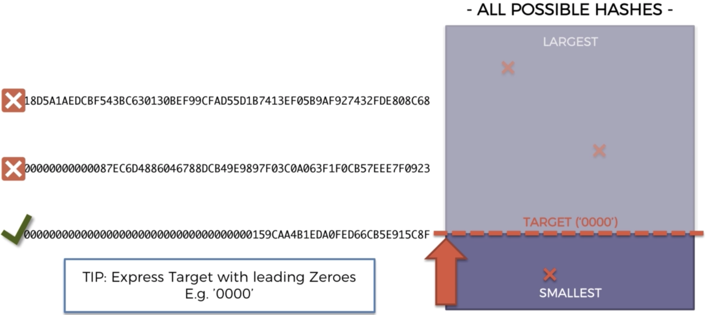
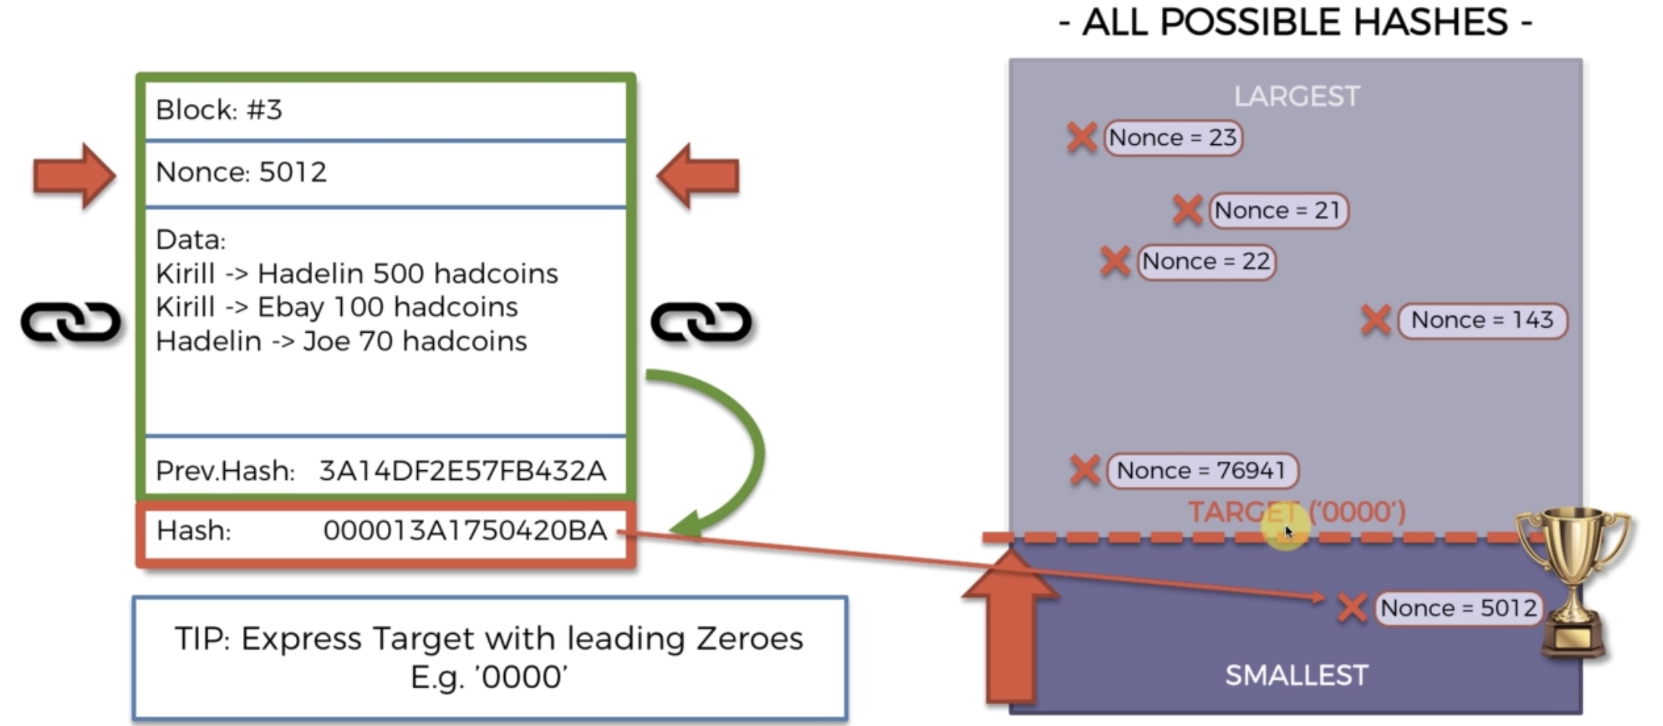
Mining
Hash is number and can be represented in map.
Target is expressed in leading zeroes
Golden Nonce – Number which will make Hash meet its Target and create a new block.
Hard Solve – Easy to verify

Slide 11
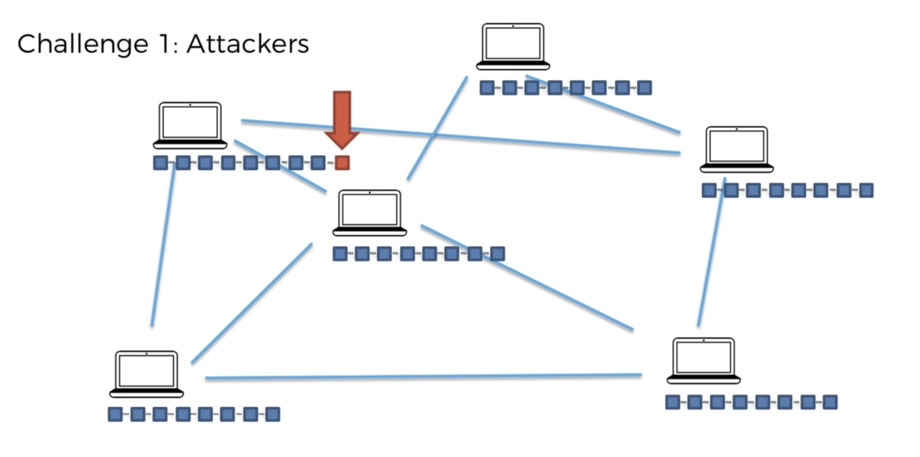
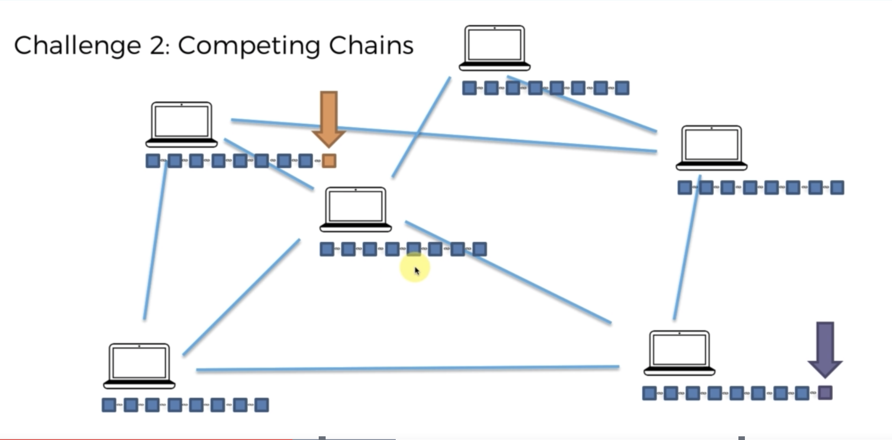
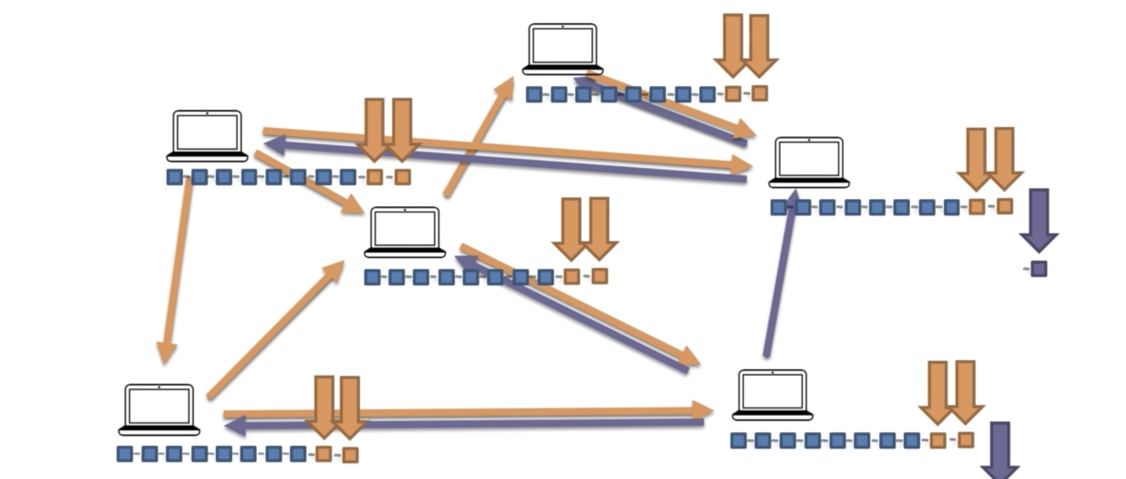
Consensus Protocol
Consensus - a general agreement about something
Types
PoW – Proof of Work (Bitcoin)
PoS – Proof of Stake (Neo)
Each Block needs meet every requirement in Protocol
Two Nodes competing to add block. Largest chain/Fastest growing is considered.

Slide 12
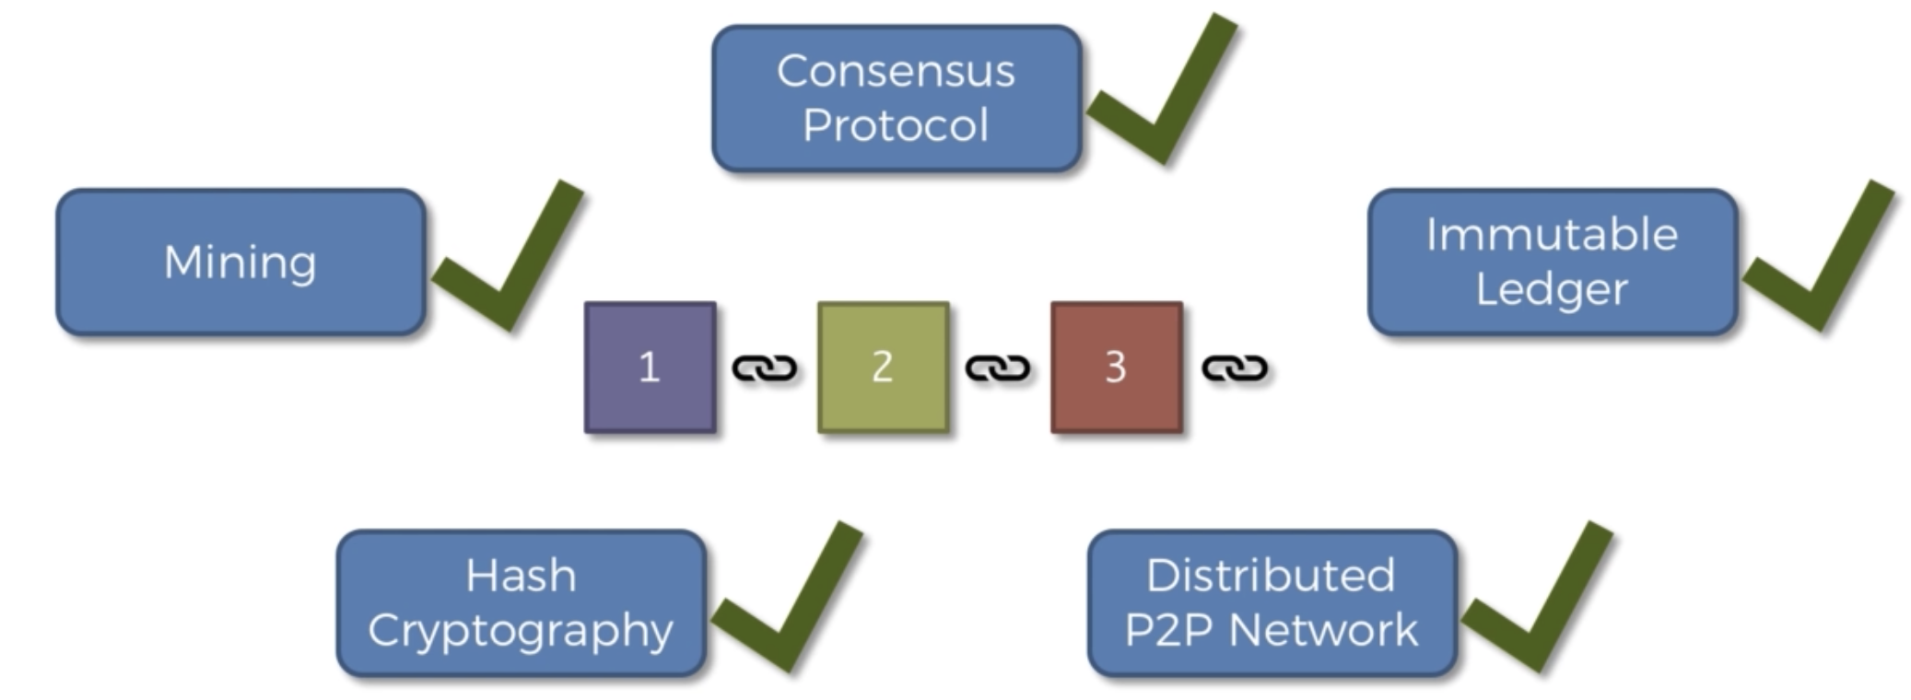
Blockchain Requirement

Slide 13
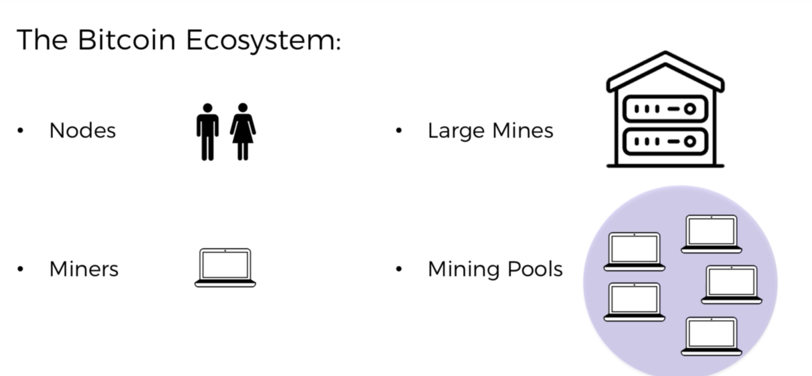
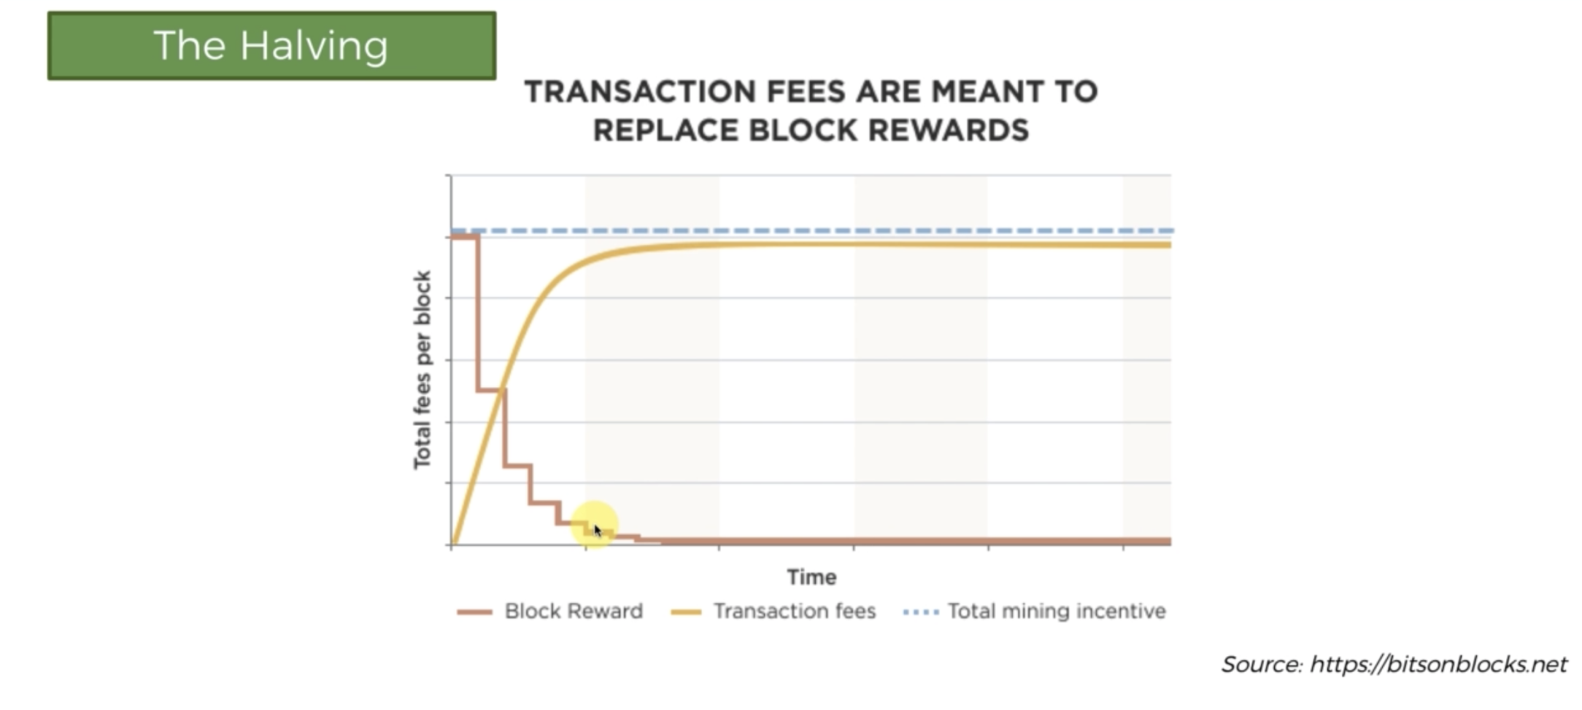
What is Cryptocurrency?
Bitcoin
Satoshi Nakamoto
1 BTC = 43L
Decentral
[3] Paper
Monetary Policy
Halving – Every 4 years reduce coins by half.
Block Frequency – 10 mins
21 Million Coins by 2140
Controlled by Algorithm
Blockchain.com

Slide 14
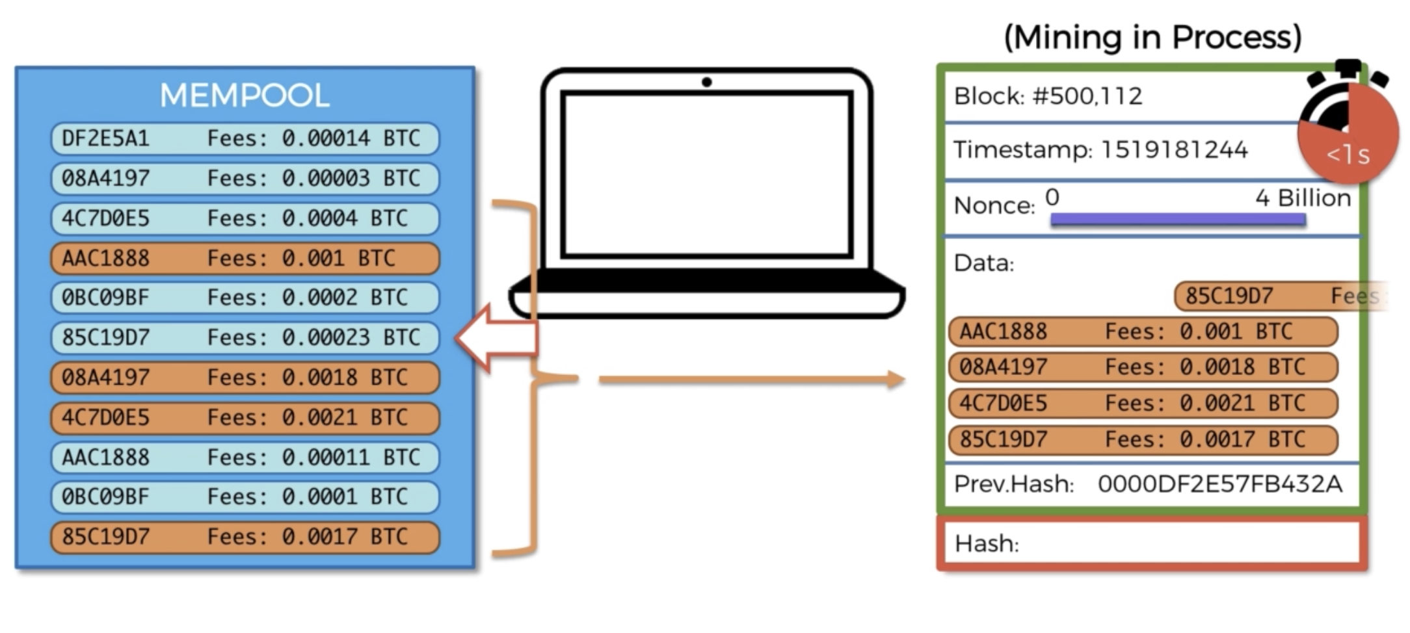
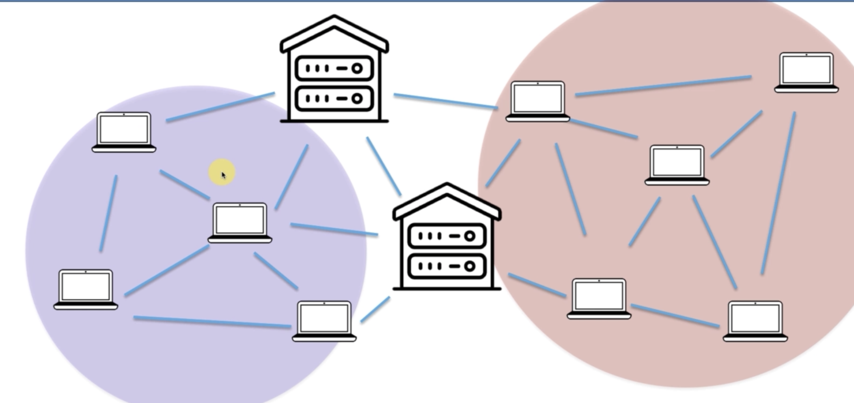
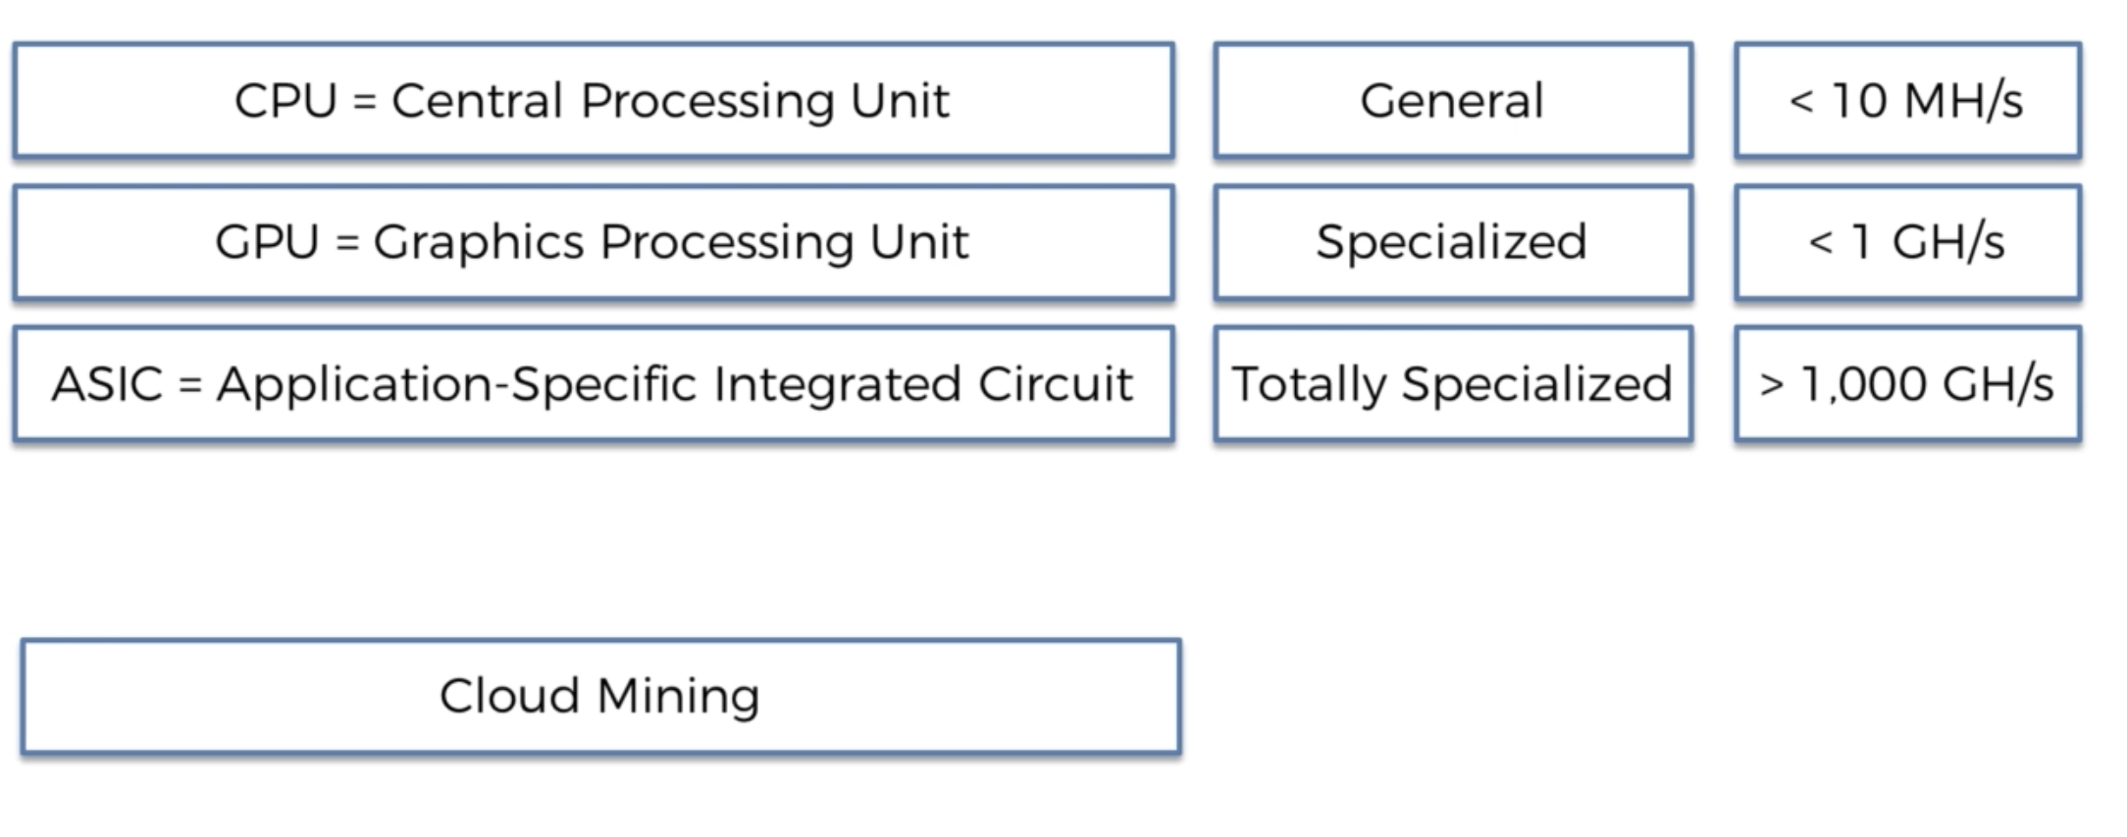
More on Bitcoin
Mining Pool
Mining Hardware
Mining Algorithm
Mempool – Stagging area of transactions before adding to block
Mining Algo
Mining Pool
Mining Hardware

Slide 15
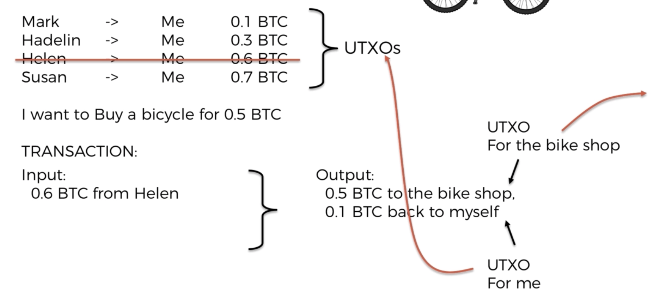
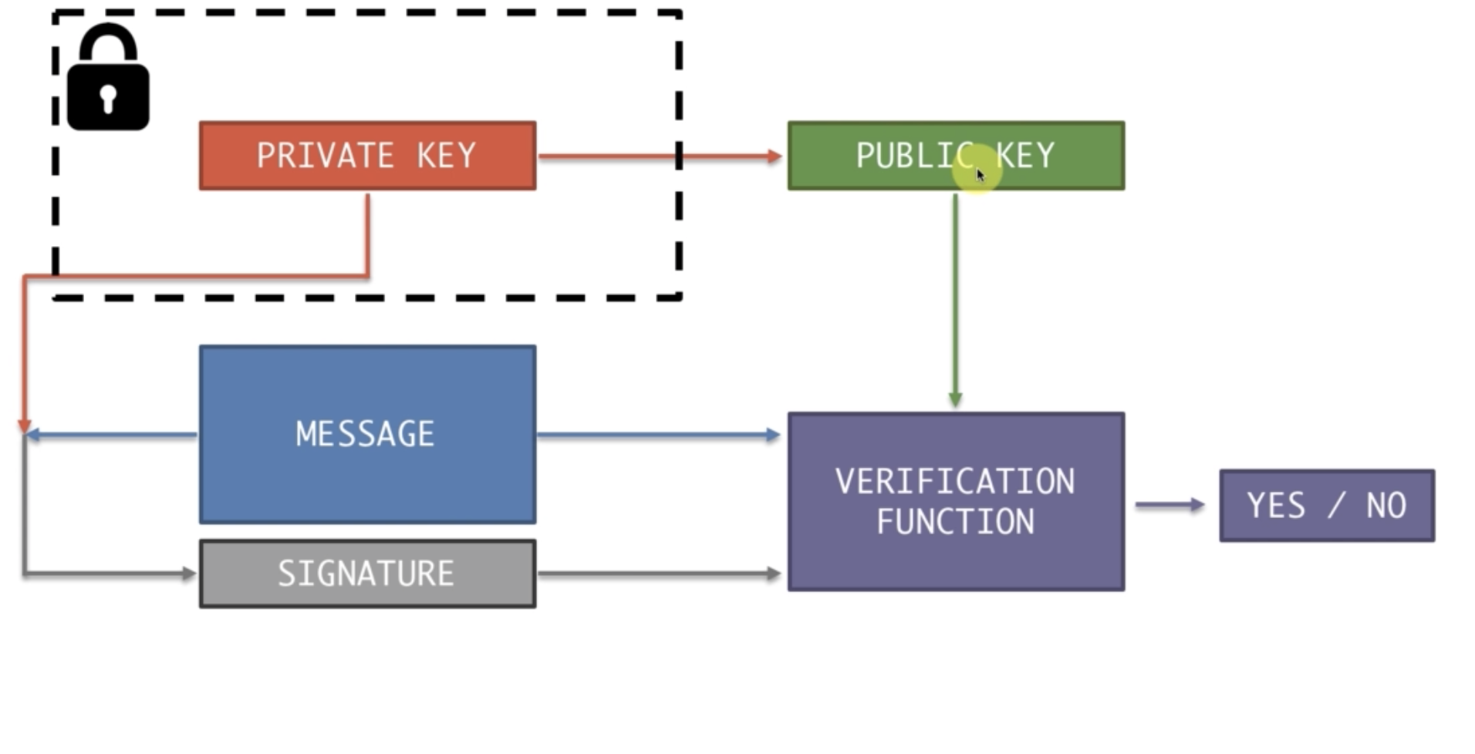
Bitcoin Transaction
Transactions are different
UTXO – Unconfirmed Transaction
Part of UTXO is fee for miners
Transactions and UTXO
Transactions Signing

Slide 16
Blockchain Applications
Real Estate: Absolute tracking of land
Agriculture: 12% GDP , 120Million Farmers
Energy in Rural: IoT + Blockchain + Cryptocurrency
Voting
Finance Sector

Slide 17
Reference
How to Timestamp Digital Document
SHA256 Paper
Bitcoin: A Peer-to-Peer Electronic Cash System
SHA256 [Video]
Bitcoin Simply Explained[Video]
Udemy Course [Video]
TEDx India Talk [Video]
3blue1brown [Video]

